Slide 1
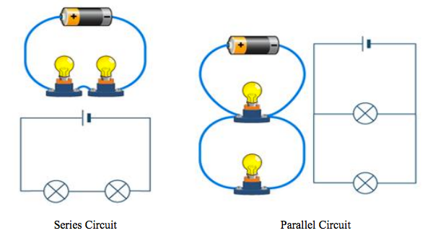
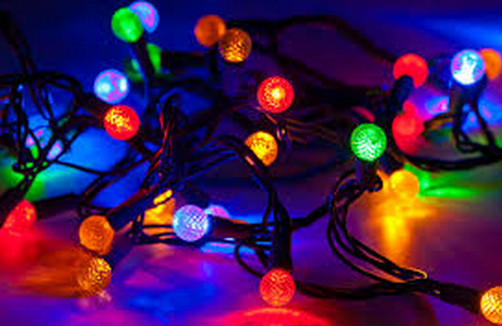
Electrical
Circuits
Learning Objectives:
1. To set up simple series and parallel circuits effectively.
2. To understand the how current differs in series and parallel circuits.

Slide 2
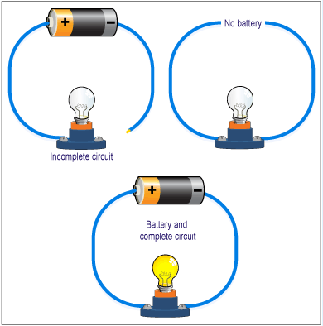
Whiteboard Starter: Making Circuits
Look at the pictures.
What is wrong with the first two circuits?
How can they be made to work?

Slide 3
Starter (3mins) – Unscramble these keywords
Unscramble the following key words
  1. Rertncu flows around a circuit
  2. Larprelal a type of circuit
  3. Rmaeetm used to measure 1
  4. Rutcici all electric components joined
  5. Lubb can be bright or dim
Write down three ways we have to be safe when using electricity.

Slide 4
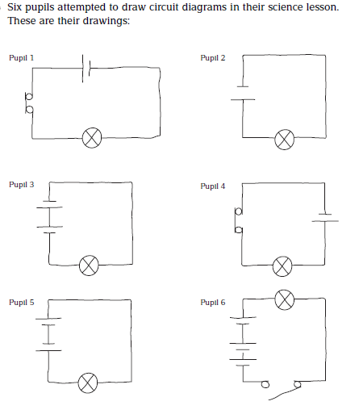
Six pupils attempted to draw circuit diagrams in their science lesson. Their drawings are opposite.
In which circuits will the bulb light up?
For those circuits where the bulb will not light, redraw the circuit diagrams so that they will.
In which of the circuits that you have drawn for Qu2 will the bulb be brightest? Explain your reasoning.
Where in a circuit does the switch need to be in order to operate the bulb correctly?

Slide 5
Series circuit

Slide 6
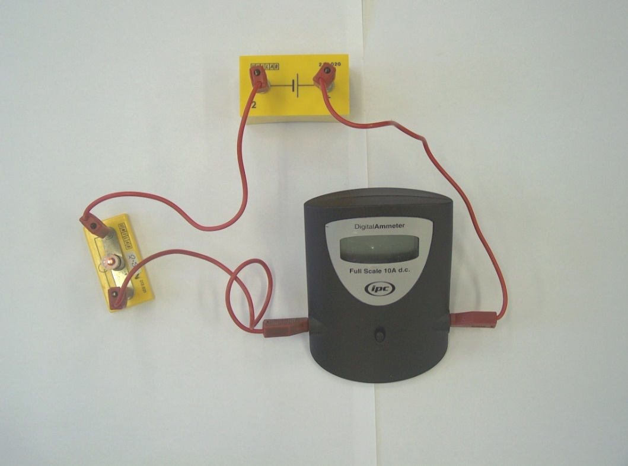
Measuring electric current
Current is the flow of electricity around a circuit
We can measure the amount of electric current flowing through a circuit using a device called an “ammeter”.
A

Slide 7
Measuring current
The unit of measure for current is the "amp" which has the symbol A.
We measure the current using a device called an ammeter. In a circuit this is given the symbol
When measuring the current through a component, the ammeter is always connected in series (in the same loop) with that component.
A
A
A

Slide 8
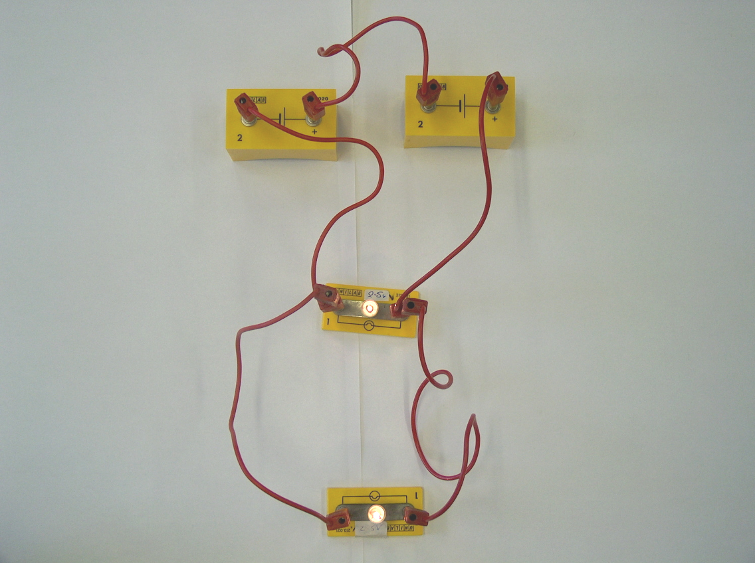
Parallel circuits
A parallel circuit is one where the current has a “choice of routes”:

Slide 9
Parallel circuits

Slide 10
Parallel and Series Circuits
Notes:
TEACHER’S NOTES
FLASH activity
Drag the components to the gaps in the circuit and press 'switch on' to test the circuit.
Drag the voltmeter onto the circuit component where the voltage is to be measured.
Reset to start again!
© Boardworks Ltd 2002

Slide 11
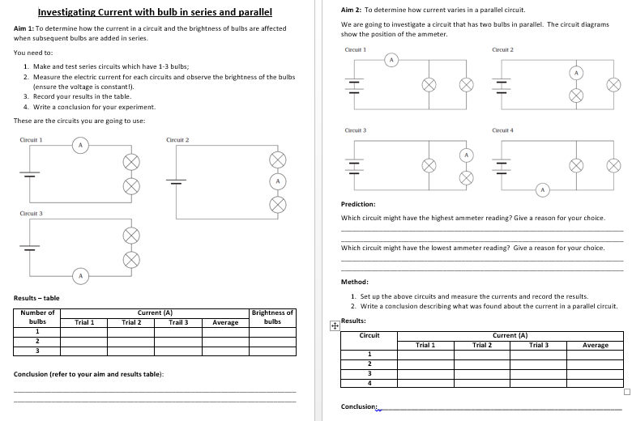
Investigating
Current
(30 mins)
Follow the instructions on the sheet to complete the practicals.
Safety:
Put newspaper on benches before setting up circuits.
Make sure the area is DRY (stay away from the taps!)

Slide 12
Current in a series circuit
If the current here is 2 amps…
The current here will be…
The current here will be…
And the current here will be…
In other words, the current in a series circuit is THE SAME at any point

Slide 13
Current in a parallel circuit
A PARALLEL circuit is one where the current has a “choice of routes”
Here comes the current…
Half of the current will go down here (assuming the bulbs are the same)…
And the rest will go down here…

Slide 14
Current in a parallel circuit
If the current here is 6 amps
And the current here will be…
The current here will be…
The current here will be…
The current here will be…

Slide 15
Changing the current (WRITE THIS IN YOUR BOOK!)
If a battery is added the current will ________ because there is a greater _____ on the electrons
If a bulb is added the current will _______ because there is greater ________ in the circuit

Slide 16
Summary for series circuits
In a series circuit the current is the same at any point in the circuit.
2. The supply voltage is shared between the components in a series circuit.
3. The current depends on the voltage in ANY circuit.
Science in Action: Go from 8 mins 30secs https://www.youtube.com/watch?v=9iv-En-aAFY

Slide 17
Advantages of parallel circuits…
There are two main reasons why parallel circuits are used more commonly than series circuits:
Extra appliances (like bulbs) can be added without affecting the output of the others
If one appliance breaks it won’t affect the others either

Slide 18
Electrical
Circuits
Learning Objectives:
1. To set up simple series and parallel circuits effectively.
2. To understand the how current differs in series and parallel circuits.

Slide 19
Measuring voltage - across a resistor or a bulb
A
Components
component
here
R
V
V
Voltage is measured by connecting the voltmeter across (or in parallel with) the component.
Voltage is measured in volts and the symbol for this is V.

Slide 20
Measuring voltage
https://youtu.be/m4jzgqZu-4s
We measure the voltage using a device called an voltmeter. In a circuit this is given the symbol
V
When measuring the voltage across a component, the voltmeter is always connected in parallel with (or across) the component.
V₁
This is still
a SERIES circuit.
V₂
V₃
The voltage supplied by the battery is shared between all the components in a SERIES circuit.
The voltage supplied by the battery is the same over all the components in a PARALLEL circuit.

Slide 21
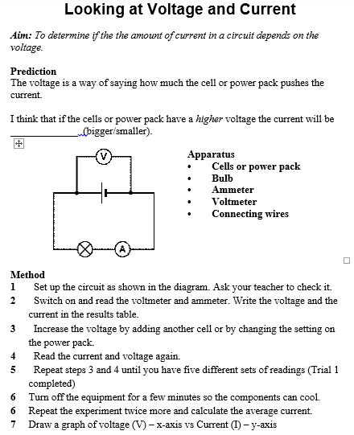
Class Practical (30 mins)
Following the method outlined on the worksheet.
1. Complete the practical.
2. Draw the graph
3. Write a conclusion
4. Glue in your sheet.
Safety:
Put newspaper on benches before setting up circuits.
Make sure the area is DRY (stay away from the taps!)

